Slide 1













CROWDFUNDING PORTAL
A donation-based fundraising portal
Savia Varghese
22PMC149

Slide 2
ABSTRACT
The Crowdfunding Portal is a web-based application to raise funds for projects across diverse categories.
Crowdfunder is developed as a donation-based fundraising portal by providing a user-friendly platform to financially support a project.
The user can donate to projects that align with his likeness and interest.
Hence this platform aims to provide financial assistance for uploaded projects with potential donors who are interested in contributing to specific causes.

Slide 3

REQUIREMENTS
User registration and
login
Project listing
Search for projects
Category
Payment

Slide 4
FEATURES & HIGHLIGHTS
Donation: Registered users can browse through the available projects, select the one they wish to donate which redirects to a donation page with project name, user details and enter the amount to donate.
Contribution logs: After a donation is made, the log will show the project title, contributor name, the amount contributed, target amount, and timestamp of contribution.
Projects viewed by category: By choosing a category, the user can view the projects that fall under that category.

Slide 5
TECHNICAL ASPECTS
Framework |  | Django
Database |  | SQLite
User Authentication |  | Django's built-in authentication system
Front-End |  | HTML, CSS, JavaScript, Bootstrap
Language used |  | Python

Slide 6
THIRD-PARTY LIBRARIES
Third-party applications or libraries in Django are pre-built components or packages developed by the community used to extend the functionality of your Django projects.
Django Jazzmin
Django pillow
Bootstrap
A drop-in app to jazz up your Django admin site, i.e. a built-in UI customizer for admin interface.
PIL (Python Imaging Library) adds many image processing features to Python.
Bootstrap is the most popular CSS Framework for developing responsive websites.

Slide 7
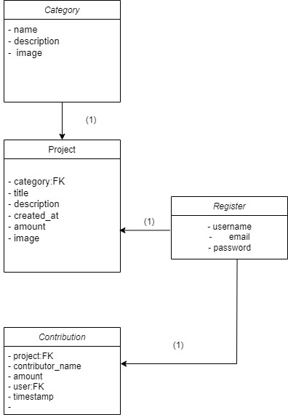
CLASS DIAGRAM

Slide 8
CHALLENGES FACED
I was confused about integrating my concept into Django and the process flow of the project. Efforts were taken to refer to a lot of crowdfunding websites to conceptualize the topic.
I had problems with the virtual environment residing in my project which lead to dysfunctionality and resulted in unexpected errors. My project had to be restarted at that moment.
While implementing the bootstrap templates in Django using CSS and JS files, they appeared to be quite difficult and generated errors.

Slide 9
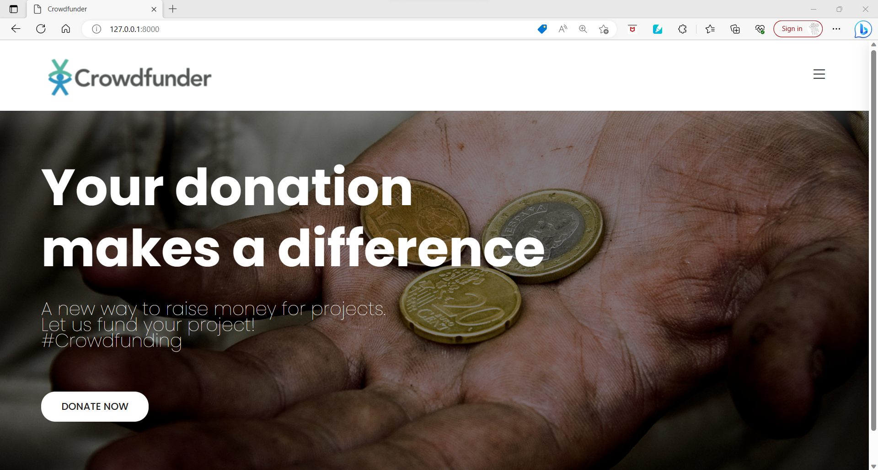
SCREENSHOTS
The user needs to login to the system in order to view and donate to projects.The login details will be used for donation purposes.

Slide 10
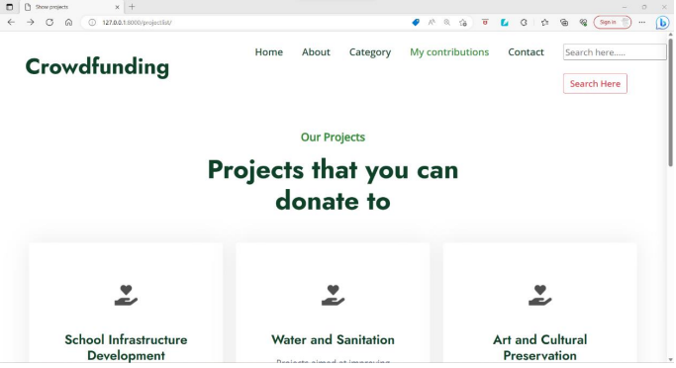
After successful login, the user is redirected to the page where uploaded projects are listed.

Slide 11
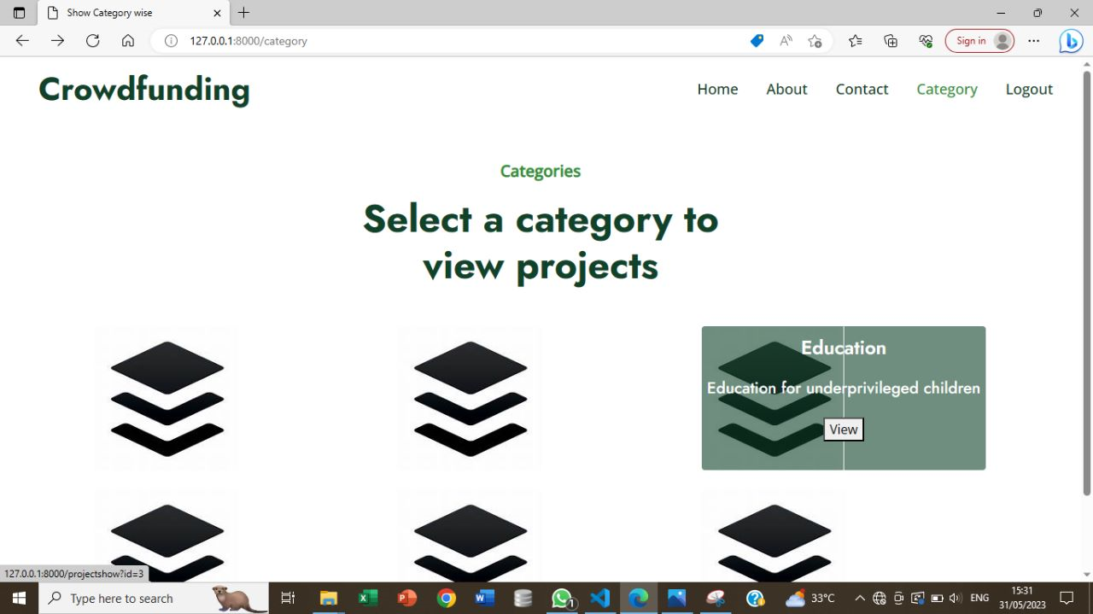
When a category is selected, the project in that category will be displayed and by clicking on “donate now” button, you will be redirected to a donation page .

Slide 12
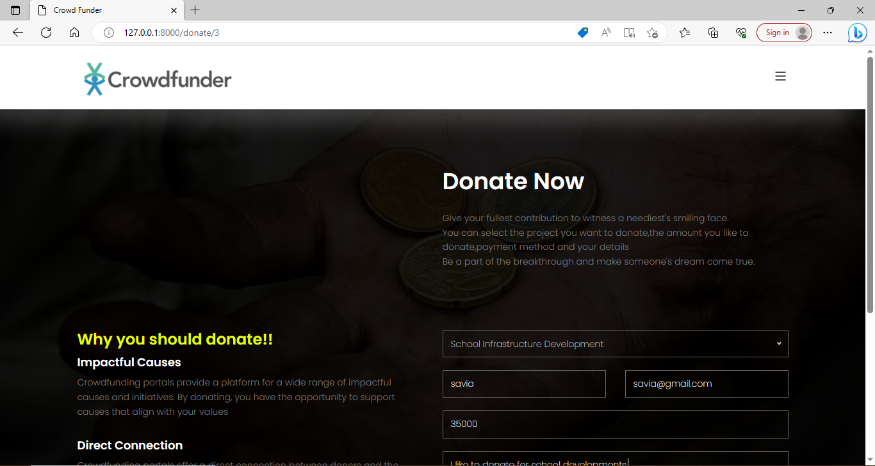
The project selected by you will be displayed there along with your details. Then, enter the amount you would like to donate and proceed to payment.

Slide 13
FUTURE ENHANCEMENTS
Integrate social media platforms to enable users to share their supported projects and attract donors.
Social Integration
Providing more detailed updates to donors about the progress and milestones of the projects they have supported. Include visual representations, such as graphs or charts.
Project Updates
To conduct campaigns, typically centered around a specific project and raise funds while campaign's duration can vary based on the project's needs.
Campaigns

Slide 14
CONCLUSION
To conclude, Crowdfunding Portal serves as a powerful platform for individuals to donate to projects thereby receiving financial support for the projects.
The portal facilitates the donation payment process and displays contribution logs.
With project listings and categorized projects, the platform offers an interface for users to explore, select, and donate to projects aligned with their interests and values.
The admin can add projects that are of relevant causes and needs funding.

Slide 15
REFERENCES
https://codecanyon.net/item/fundorex-crowdfunding-platform/33286096
https://docs.djangoproject.com/en/4.2/
Fundorex - Crowdfunding Platform - xgenious
https://bootstrapmade.com/
https://themewagon.com/

